Slide 1
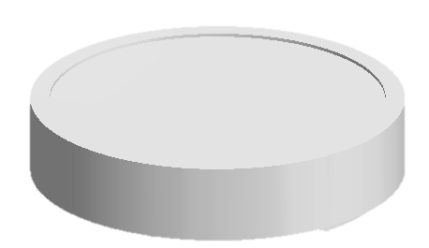
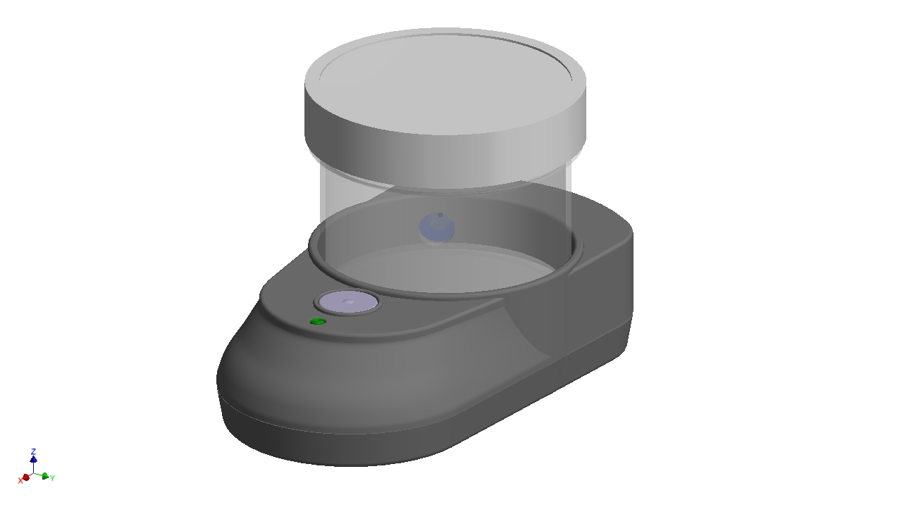
Add a shroud

Slide 2
Give Exploded View
Sample Cup By Itself
Our Device with its Shroud

